Slide 1

File and Printer sharing in Windows NT Environment
NATIONAL INSTITUTE OF ELECTRONICS AND INFORMATION TECHNOLOGY
Birla Farms, Bada Phull, Ropar
NIELIT ‘O’-Level
IT Tools and Network basics

Slide 2
Introduction to Internet and WWW

Slide 3
Index
Basic of Computer Networks
Computer Network components
Unique Identifiers of Network
Types of Network
Network Topology
Introduction to Internet
Internet based services
Applications of Internet
WWW, HTTP, URL, IP Address, ISP
Modes of Connecting Internet
Dial-up
Broadband
ISDN
Wifi
USB Tethering
Hotspot
IP/MAC address
Finding your device’s IP and MAC address
Web Browsers and Search Engines
Downloading and Printing Web pages.

Slide 4
Basics of Computer Networks and Network Topology

Slide 5
Computer Network
It is the interconnection of multiple devices, generally termed as Hosts connected using multiple paths for the purpose of sending/receiving data or media.
There are also multiple devices or mediums which help in the communication between two different devices which are known as Network devices. Ex: Router, Switch, Hub, Bridge.
You can establish a network connection using either cable or wireless media.
Every network involves hardware and software that connects computers and tools.

Slide 6
Advantages of a Computer Network
Here are the fundamental benefits/pros of using Computer Networking:
It helps you to connect with multiple computers together to send and receive information when accessing the network.
It helps you to share printers, scanners, and email.
It helps you to share information at very fast speed
Electronic communication is more efficient and less expensive than without the network.

Slide 7
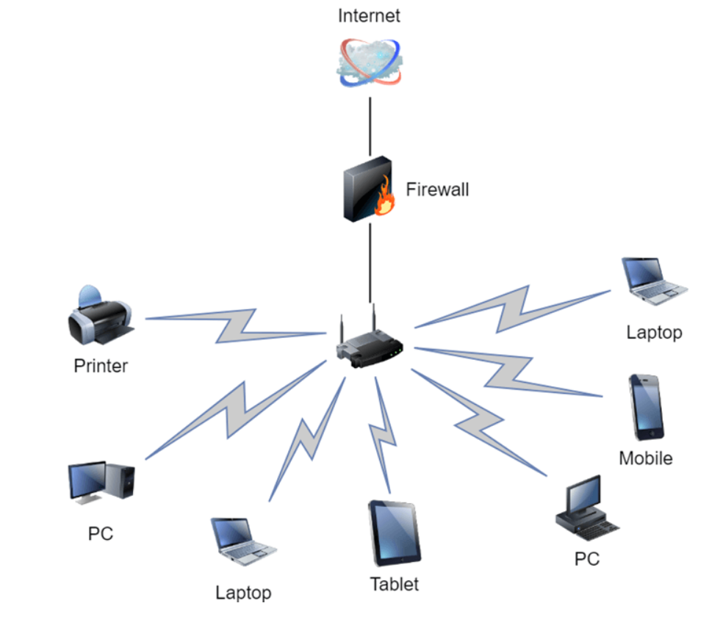
Computer Network Components

Slide 8
Computer Network Components
Switches
Switches work as a controller which connects computers, printers, and other hardware devices to a network in a campus or a building.
It allows devices on your network to communicate with each other, as well as with other networks. It helps you to share resources and reduce the costing of any organization.
Routers
Routers help you to connect with multiple networks. It enables you to share a single internet connection with multiple devices and saves money. This networking component acts as a dispatcher, which allows you to analyze data sent across a network. It automatically selects the best route for data to travel and send it on its way.
Servers:
Servers are computers that hold shared programs, files, and the network operating system. Servers allow access to network resources to all the users of the network.

Slide 9
Computer Network Components
Clients:
Clients are computer devices which access and uses the network as well as shares network resources. They are also users of the network, as they can send and receive requests from the server.
Transmission Media:
Transmission media is a carrier used to interconnect computers in a network, such as coaxial cable, twisted-pair wire, and optical fiber cable. It is also known as links, channels, or lines.
Shared Data:
Shared data are data which is shared between the clients such as data files, printer access programs, and email.
Network Interface Card:
Network Interface card sends, receives data, and controls data flow between the computer and the network.
Local Operating System:
A local OS which helps personal computers to access files, print to a local printer and uses one or more disk and CD drives which are located on the computer.
Network Operating System:
The network operating system is a program which runs on computers and servers. It allows the computers to communicate via network.

Slide 10
Computer Network Components
Protocol:
A protocol is the set of defined rules that allows two entities to communicate across the network. Some standard protocols used for this purpose are IP, TCP, UDP, FTP, etc.
Hub:
Hub is a device that splits network connection into multiple computers. It acts a distribution center so whenever a computer requests any information from a computer or from the network it sends the request to the hub through a cable. The hub will receive the request and transmit it to the entire network.
LAN Cable:
Local Area Network(LAN) cable is also called as Ethernet or data cable. It is used for connecting a device to the internet.
OSI:
OSI stands for Open Systems Interconnection. It is a reference model which allows you to specify standards for communications

Slide 11
Unique Identifiers of Network
Hostname:
Every device of the network is associated with a unique device, which is called hostname.
IP Address:
IP (Internet Protocol) address is as a unique identifier for each device on the Internet. Length of the IP address is 32-bits. IPv6 address is 64 bits.
DNS Server:
DNS stands for Domain Name System. It is a server which translates URL or web addresses into their corresponding IP addresses.
MAC Address:
MAC (Media Access Control Address) is known as a physical address is a unique identifier of each host and is associated with the NIC (Network Interface Card). General length of MAC address is : 12-digit/ 6 bytes/ 48 bits

Slide 12
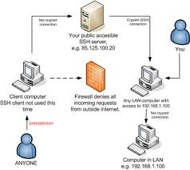
Unique Identifiers of Network
Port:
Port is a logical channel which allows network users to send or receive data to an application. Every host can have multiple applications running. Each of these applications are identified using the port number on which they are running.
BoxTutorials

Slide 13
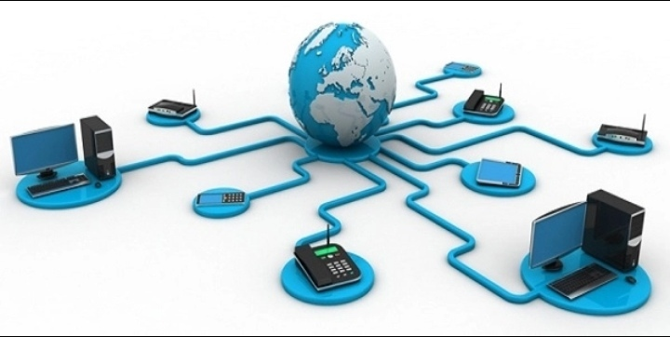
Types of computer network
There are various types of computer networks available. We can categorize them according to their size as well as their purpose.
The size of a network should be expressed by the geographic area and number of computers, which are a part of their networks. It includes devices housed in a single room to millions of devices spread across the world.
ttafakar.com

Slide 14
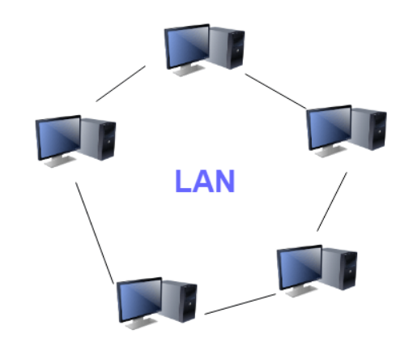
Types of computer network
LAN (Local Area Network) - A local area network (LAN) is a group of computers and associated devices that share a common communications line or wireless link to a server. Typically, a LAN encompasses computers and peripherals connected to a server within a distinct geographic area such as an office or a commercial establishment.

Slide 15
Types of computer network
Advantages of LAN
Computer resources like hard-disks, DVD-ROM, and printers can share local area networks. This significantly reduces the cost of hardware purchases.
You can use the same software over the network instead of purchasing the licensed software for each client in the network.
Data of all network users can be stored on a single hard disk of the server computer.
You can easily transfer data and messages over networked computers.
It will be easy to manage data at only one place, which makes data more secure.
Local Area Network offers the facility to share a single internet connection among all the LAN users.

Slide 16
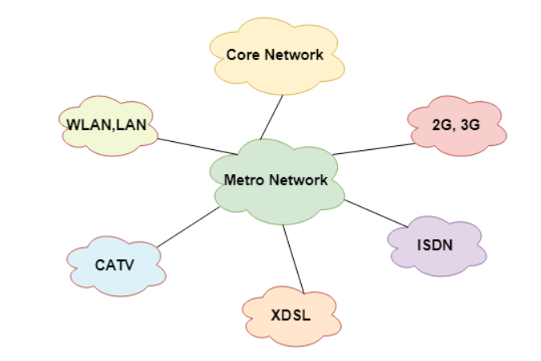
Types of computer network
MAN(Metropolitan Area Network) - A metropolitan area network is a computer network that interconnects users with computer resources in a geographic area or region larger than that covered by even a large local area network (LAN) but smaller than the area covered by a wide area network (WAN). The term is applied to the interconnection of networks in a city into a single larger network (which may then also offer efficient connection to a wide area network). It is also used to mean the interconnection of several local area networks by bridging them with backbone lines.

Slide 17
Types of computer network
Advantages of MAN
It offers fast communication using high-speed carriers, like fiber optic cables.
It provides excellent support for an extensive size network and greater access to WANs.
The dual bus in MAN network provides support to transmit data in both directions concurrently.
A MAN network mostly includes some areas of a city or an entire city.

Slide 18
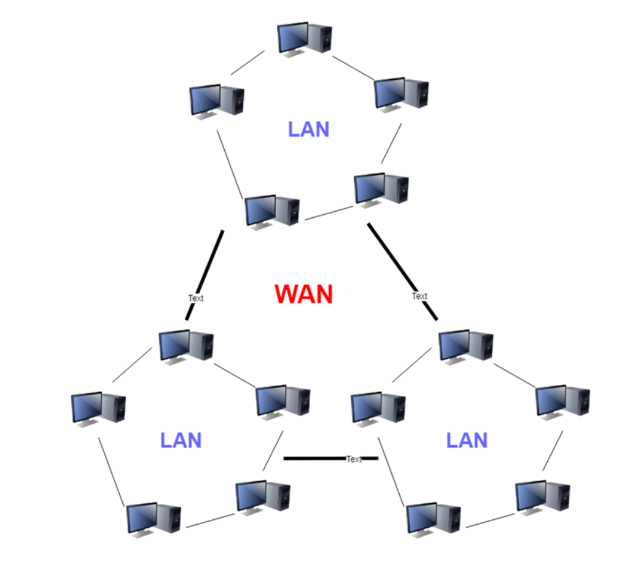
Types of computer network
WAN (Wide Area Network) - A wide area network (WAN) is a network that exists over a large-scale geographical area. A WAN connects different smaller networks, including local area networks (LANs) and metro area networks (MANs). This ensures that computers and users in one location can communicate with computers and users in other locations. WAN implementation can be done either with the help of the public transmission system or a private network.

Slide 19
Types of computer network
Advantages of WAN
WAN helps you to cover a larger geographical area. Therefore business offices situated at longer distances can easily communicate.
Contains devices like mobile phones, laptop, tablet, computers, gaming consoles, etc.
WLAN connections work using radio transmitters and receivers built into client devices.

Slide 20
Network Topology

Slide 21
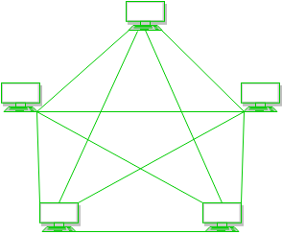
Network Topology
The arrangement of a network which comprises of nodes and connecting lines via sender and receiver is referred as network topology. The various network topologies are :
a) Mesh Topology :
In mesh topology, every device is connected to another device via particular channel.

Slide 22
Types of Network Topology
In mesh topology, every device is connected with another via dedicated channels. These channels are known as links.
If suppose, N number of devices are connected with each other in mesh topology, then total number of ports that is required by each device is ​ N-1. In the Figure 1, there are 5 devices connected to each other, hence total number of ports required is 4.
If suppose, N number of devices are connected with each other in mesh topology, then total number of dedicated links required to connect them is ^{N}C₂ i.e. N(N-1)/2. In the Figure 1, there are 5 devices connected to each other, hence total number of links required is 5*4/2 = 10.

Slide 23
Types of Network Topology
Advantages
It is robust.
Fault is diagnosed easily. Data is reliable because data is transferred among the devices through dedicated channels or links.
Provides security and privacy.
Disadvantages
Installation and configuration is difficult.
Cost of cables are high as bulk wiring is required, hence suitable for less number of devices.
Cost of maintenance is high.

Slide 24
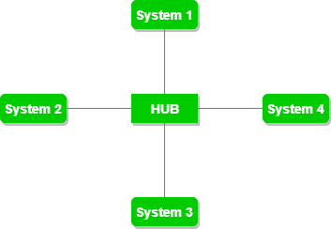
Types of Network Topology
b) Star Topology :
In star topology, all the devices are connected to a single hub through a cable. This hub is the central node and all others nodes are connected to the central node. The hub can be passive ​in nature i.e. not intelligent hub such as broadcasting devices, at the same time the hub can be intelligent known as active ​hubs. Active hubs have repeaters in them.

Slide 25
Types of Network Topology
Advantages
If N devices are connected to each other in star topology, then the number of cables required to connect them is N. So, it is easy to set up.
Each device require only 1 port i.e. to connect to the hub.
Disadvantages
If the concentrator (hub) on which the whole topology relies fails, the whole system will crash down.
Cost of installation is high.
Performance is based on the single concentrator i.e. hub.

Slide 26
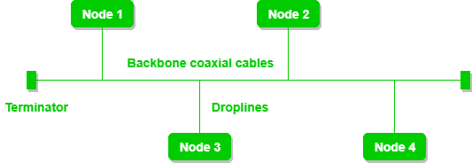
Types of Network Topology
c) Bus Topology :
Bus topology is a network type in which every computer and network device is connected to single cable. It transmits the data from one end to another in single direction. No bi-directional feature is in bus topology.

Slide 27
Types of Network Topology
In bus topology contains a shared backbone cable. The nodes are connected to the channel via drop lines
Advantages
If N devices are connected to each other in bus topology, then the number of cables required to connect them is 1 ​which is known as backbone cable and N drop lines are required.
Cost of the cable is less as compared to other topology, but it is used to built small networks.
Disadvantages
If the common cable fails, then the whole system will crash down.
If the network traffic is heavy, it increases collisions in the network. To avoid this, various protocols are used in MAC layer known as Pure Aloha, Slotted Aloha, CSMA/CD etc.

Slide 28
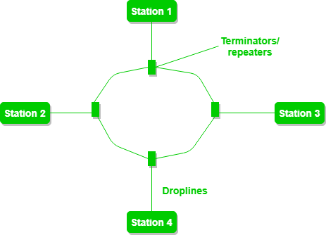
Types of Network Topology
d) Ring Topology :
In this topology, it forms a ring connecting a devices with its exactly two neighboring devices.

Slide 29
Types of Network Topology
Advantages
The possibility of collision is minimum in this type of topology.
Cheap to install and expand.
Disadvantages
Troubleshooting is difficult in this topology.
Addition of stations in between or removal of stations can disturb the whole topology.

Slide 30
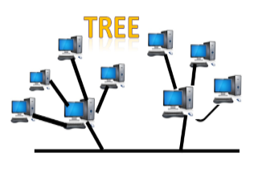
Types of Network Topology
e) Tree Topology :
Tree topology combines the characteristics of bus topology and star topology. A tree topology is a type of structure in which all the computers are connected with each other in hierarchical fashion. The top-most node in tree topology is known as a root node, and all other nodes are the descendants of the root node. There is only one path exists between two nodes for the data transmission. Thus, it forms a parent-child hierarchy.

Slide 31
Types of Network Topology
Advantages
Tree topology is mainly used to provide broadband transmission, i.e., signals are sent over long distances without being attenuated.
We can add the new device to the existing network.
The whole network is divided into segments known as star networks which can be easily managed and maintained.
Error detection and error correction are very easy in a tree topology.
The breakdown in one station does not affect the entire network.
It has point-to-point wiring for individual segments.
Disadvantages
If any fault occurs in the node, then it becomes difficult to troubleshoot the problem.
Devices required for broadband transmission are very costly.
A tree topology mainly relies on main bus cable and failure in main bus cable will damage the overall network.
If new devices are added, then it becomes difficult to reconfigure.

Slide 32
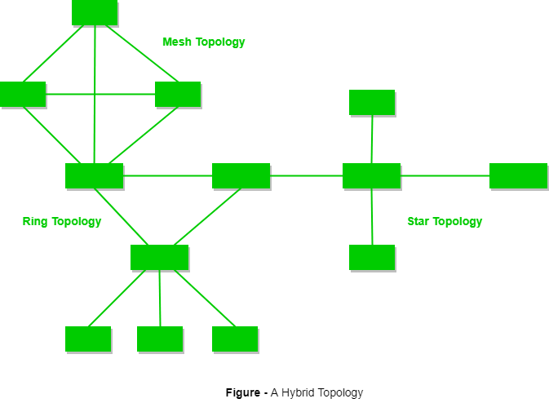
Types of Network Topology
e) Hybrid Topology :
​This topology is a collection of two or more topologies which are described above. This is a scalable topology which can be expanded easily. It is reliable one but at the same it is a costly topology.

Slide 33
Introduction to Internet

Slide 34

What is Internet?
The Internet is essentially a global network of computing resources. It refers to network of networks.
It uses the standard Internet Protocol (TCP/IP) for communication where each computer is recognized by a globally unique address known as IP address.
You can think of the Internet as a physical collection of routers and circuits as a set of shared resources.
Javatpoint

Slide 35
Evolution
The concept of Internet was originated in 1969 and has undergone several technological & Infrastructural changes as discussed below:
The origin of Internet devised from the concept of Advanced Research Project Agency Network (ARPANET).
ARPANET was developed by United States Department of Defense.
Basic purpose of ARPANET was to provide communication among the various bodies of government.
Initially, there were only four nodes, formally called Hosts.
In 1972, the ARPANET spread over the globe with 23 nodes located at different countries and thus became known as Internet.
By the time, with invention of new technologies such as TCP/IP protocols, DNS, WWW, browsers, scripting languages etc.,Internet provided a medium to publish and access information over the web.

Slide 36
Internet-Based Services
Some of the basic services available to Internet users are −
Email − A fast, easy, and inexpensive way to communicate with other Internet users around the world.
Telnet − Allows a user to log into a remote computer as though it were a local system.
FTP − Allows a user to transfer virtually every kind of file that can be stored on a computer from one Internet-connected computer to another.
UseNet news − A distributed bulletin board that offers a combination news and discussion service on thousands of topics.
World Wide Web (WWW) − A hypertext interface to Internet information resources.

Slide 37
Applications of Internet
The internet is treated as one of the biggest invention. It has a large number of uses.
1. Communication
2. Job searches
3. Finding books and study material
4. Health and medicine
5. Travel
6. Entertainment
7. Shopping
8. Stock market updates
9. Research
10. Business
11. E-Commerce
12. Social networking

Slide 38

What is WWW?
WWW stands for World Wide Web. A technical definition of the World Wide Web is − All the resources and users on the Internet that are using the Hypertext Transfer Protocol (HTTP).
A broader definition comes from the organization that Web inventor Tim Berners-Lee helped found, the World Wide Web Consortium (W3C): The World Wide Web is the universe of network-accessible information, an embodiment of human knowledge.
In simple terms, The World Wide Web is a way of exchanging information between computers on the Internet, tying them together into a vast collection of interactive multimedia resources.
shutterstock

Slide 39

HTTP
HTTP stands for Hypertext Transfer Protocol. This is the protocol being used to transfer hypertext documents that makes the World Wide Web possible.
It is a client/server protocol used to exchange hypertext documents. The main thing you need to know is that HTTP is a language spoken between your web browser (client software) and a web server (server software) so that they can communicate with each other and exchange files.
youtube

Slide 40
URL
URL stands for Uniform Resource Locator, and is used to specify addresses on the World Wide Web. A URL is the fundamental network identification for any resource connected to the web (e.g., hypertext pages, images, and sound files).
A URL will have the following format −
protocol://hostname/other_info
The protocol specifies how information is transferred from a link. The protocol used for web resources is HyperText Transfer Protocol (HTTP). Other protocols compatible with most web browsers include FTP, telnet, newsgroups, and Gopher.
The protocol is followed by a colon, two slashes, and then the domain name. The domain name is the computer on which the resource is located.
Links to particular files or subdirectories may be further specified after the domain name. The directory names are separated by single forward slashes.

Slide 41
Website
Website is a location on web and is hosted on a web server. It is a set of related web pages. It is accessed using Internet address known as Uniform Resource Locator.
Each page available on the website is called a web page and first page of any website is called home page for that site.
Websites are dedicated to a particular topic or purpose, such as news, education, commerce, entertainment, or social networking
A person can access websites from a range of devices like desktops, laptops, tablets, smartphones etc.
The software application that is required to be installed on the device for accessing a website is called a web browser.
For example :google.com ,amazon.com etc.

Slide 42
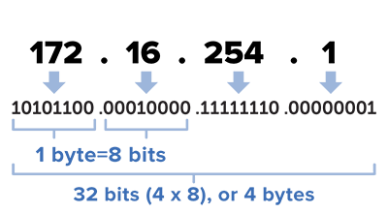
IP address
An IP address is a 32-bit number that uniquely identifies a host (computer or other device, such as a printer or router) on a TCP/IP network.
IP addresses are normally expressed in dotted-decimal format, with four numbers separated by periods, such as 192.168.123.132. To understand how subnet masks are used to distinguish between hosts, networks, and subnetworks, examine an IP address in binary notation.
For example, the dotted-decimal IP address 192.168.123.132 is (in binary notation) the 32 bit number
FS community

Slide 43
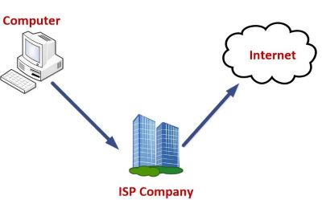
ISP
ISP stands for Internet Service Provider. It is a company that provides access to the internet and similar services such as Website designing and virtual hosting. For example, when you connect to the Internet, the connection between your Internet-enabled device and the internet is executed through a specific transmission technology that involves the transfer of information packets through an Internet Protocol route.

Slide 44
Modes of Connecting Internet
Data is transmitted through different technologies, including cable modem, dial-up, DSL, high speed interconnects. Accordingly, based on the method of data transmission, the Internet access provided by ISPs can be divided into many types, some of which are as follows:
Dial-up Internet access: It is the oldest technology to provide Internet access by modem to modem connection using telephone lines. In this method, the user's computer is connected to a modem with a telephone line. This method has become outdated today due to slow connection speed. However, in remote areas, this method can be used where the broadband network is not available.

Slide 45
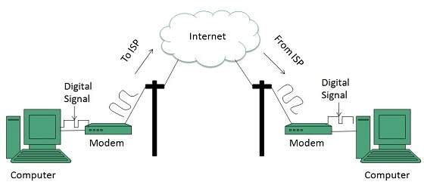
Modes of Connecting Internet
Accessing internet using modem:

Slide 46
Modes of Connecting Internet
DSL: DSL, which stands for 'digital subscriber line' is an advanced version of the dial-up Internet access method. It uses high frequency to execute a connection over the telephone network and allows the internet and the phone connection to run on the same telephone line. This method offers an Asymmetric Digital Subscriber (ADSL), where the upload speed is less than the download speed, and a Symmetric Digital Subscriber Line (SDSL), which offers equal upload and download speeds. Out of these two, ADSL is more popular among users and is popularly known as DSL.

Slide 47
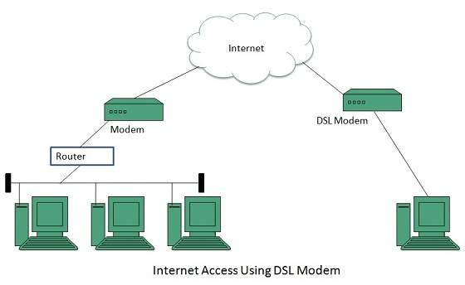
Modes of Connecting Internet
DSL

Slide 48
Modes of Connecting Internet
Wireless Broadband (WiBB): It is a modern broadband technology for Internet access. It allows high-speed wireless internet within a large area. To use this technology, you are required to place a dish on the top of your house and point it to the transmitter of your Wireless Internet Service Provider (WISP).
Wi-Fi Internet: It is the short form for "wireless fidelity," which is a wireless networking technology that provides wireless high-speed Internet connections using radio waves. To use the internet, you are required to be within the range of wi-fi network. It is commonly used in public places such as hotels, airports, restaurants to provide internet access to customers.

Slide 49
Modes of Connecting Internet
ISDN: It is a short form of Integrated Services Digital Network. It is a telephone system network which integrates a high-quality digital transmission of voice and data over the same standard phone line. It offers a fast upstream and downstream Internet connection speed and allows both voice calls and data transfer.
Ethernet: It is a wired LAN (Local Area Network) where computers are connected within a primary physical space. It enables devices to communicate with each other via a protocol (a set of rules or common network language). It may provide different speeds such as 10 Mbps, 100 Mbps and 10 Gbps.

Slide 50
Modes of Connecting Internet
Hotspot (Wi-fi) : A hotspot is a physical location where people may obtain Internet access, typically using Wi-Fi technology, via a wireless local-area network (WLAN) using a router connected to an Internet service provider.
Public hotspots may be created by a business for use by customers, such as coffee shops or hotels. Public hotspots are typically created from wireless access points configured to provide Internet access, controlled to some degree by the venue. In its simplest form, venues that have broadband Internet access can create public wireless access by configuring an access point (AP), in conjunction with a router to connect the AP to the Internet. A single wireless router combining these functions may suffice.
A private hotspot, often called tethering, may be configured on a smartphone or tablet that has a network data plan, to allow Internet access to other devices via Bluetooth pairing, or through the RNDIS protocol over USB, or even when both the hotspot device and the device[s] accessing it are connected to the same Wi-Fi network but one which does not provide Internet access. Similarly, a Bluetooth or USB OTG can be used by a mobile device to provide Internet access via Wi-Fi instead of a mobile network, to a device that itself has neither Wi-Fi nor mobile network capability.

Slide 51
Modes of Connecting Internet
USB Tethering : Tethering, or phone-as-modem (PAM), is the sharing of a mobile device's Internet connection with other connected computers. Connection of a mobile device with other devices can be done over wireless LAN (Wi-Fi), over Bluetooth or by physical connection using a cable and is called USB Tethering.
If tethering is done over WLAN, the feature may be branded as a personal or mobile hotspot, which allows the device to serve as a portable router. Mobile hotspots may be protected by a PIN or password. The Internet-connected mobile device can act as a portable wireless access point and router for devices connected to it.

Slide 52
IP/MAC Address
Both MAC Address and IP Address are used to uniquely define a device on the internet. NIC Card’s Manufacturer provides the MAC Address, on the other hand Internet Service Provider provides IP Address.
The main difference between MAC and IP address is that, MAC Address is used to ensure the physical address of computer. It uniquely identifies the devices on a network. While IP address are used to uniquely identifies the connection of network with that device take part in a network.

Slide 53
IP/MAC Address
Both MAC Address and IP Address are used to uniquely define a device on the internet. NIC Card’s Manufacturer provides the MAC Address, on the other hand Internet Service Provider provides IP Address.
The main difference between MAC and IP address is that, MAC Address is used to ensure the physical address of computer. It uniquely identifies the devices on a network. While IP address are used to uniquely identifies the connection of network with that device take part in a network.

Slide 54
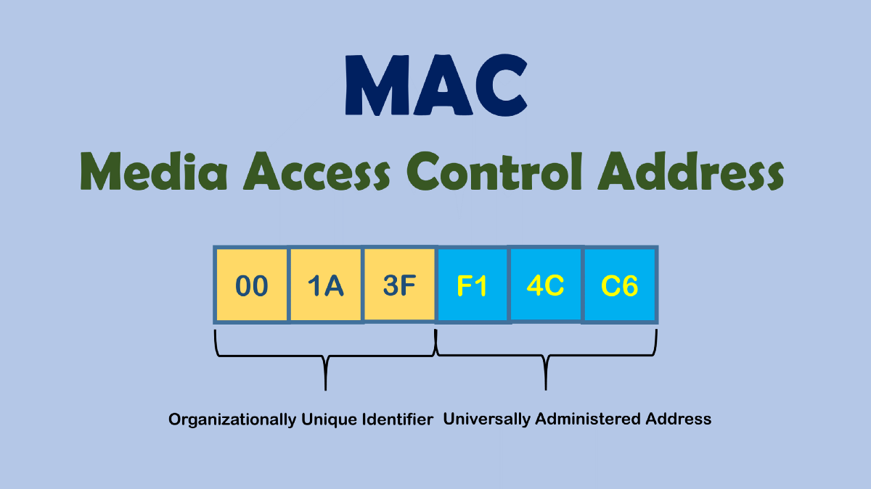
Finding your Device’s Mac address
A physical address displays for each adapter. The physical address is your device’s MAC address.
Click Windows Start or press the Windows key.
In the search box, type cmd.
Press the Enter key. A command window displays.
Type ipconfig /all.
Press Enter.
Medium

Slide 55
Finding your Device’s IP address
Click the Start icon and select Settings.
Click the Network & Internet icon.
To view the IP address of a wired connection, select Ethernet on the left menu pane and select your network connection, your IP address will appear next to "IPv4 Address".
To view the IP address of a wireless connection, select WiFi on the left menu pane and click Advanced Options, your IP address will appear next to "IPv4 Address".

Slide 56
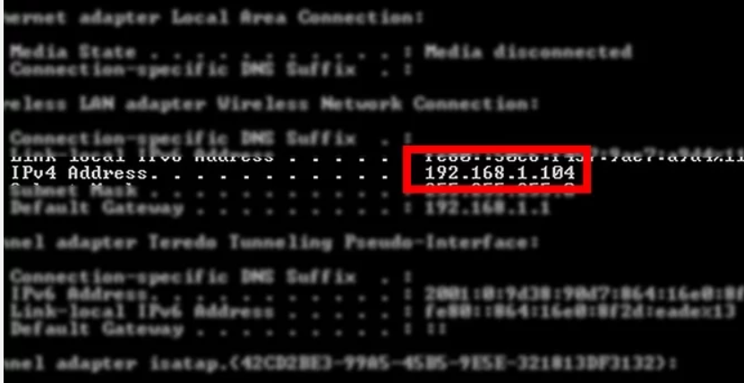
Finding your Device’s IP address through command prompt
Click Windows Start or press the Windows key.
In the search box, type cmd.
Press the Enter key. A command window displays.
Type ipconfig
Press Enter.

Slide 57
Web Browsers and Search engines

Slide 58
Web Browsers
A web browser (commonly referred to as a browser) is a software application for accessing information on the World Wide Web. When a user requests a particular website, the web browser retrieves the necessary content from a web server and then displays the resulting web page on the user's device.
On the Web, when you navigate through pages of information, this is commonly known as web browsing or web surfing.

Slide 59
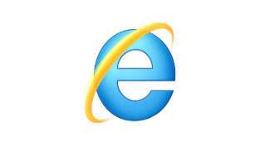
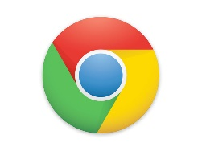


Some popular web browsers
Internet explorer :
Internet Explorer (IE) is a product from software giant Microsoft. This is the most commonly used browser. This was introduced in 1995 along with Windows 95 launch and it has passed Netscape popularity in 1998.
Google Chrome
This web browser is developed by Google and its beta version was first released on September 2, 2008 for Microsoft Windows. Today, chrome is known to be one of the most popular web browser with its global share of more than 50%.
Mozilla Firefox
Firefox is a new browser derived from Mozilla. It was released in 2004 and has grown to be the second most popular browser on the Internet.
Safari
Safari is a web browser developed by Apple Inc. and included in Mac OS X. It was first released as a public beta in January 2003. Safari has very good support for latest technologies like XHTML, CSS2 etc.

Slide 60


Some popular web browsers
Opera
Opera is smaller and faster than most other browsers, yet it is full- featured. Fast, user-friendly, with keyboard interface, multiple windows, zoom functions, and more. Java and non Java-enabled versions available. Ideal for newcomers to the Internet, school children, handicap and as a front-end for CD-Rom and kiosks.
Internet edge
Microsoft Edge is a web browser developed by Microsoft. It was first released for Windows 10 and Xbox One in 2015, then for many other os. Microsoft Edge is the default web browser on Windows 10, Windows 10 Mobile, replacing Internet Explorer 11 and Internet Explorer Mobile

Slide 61
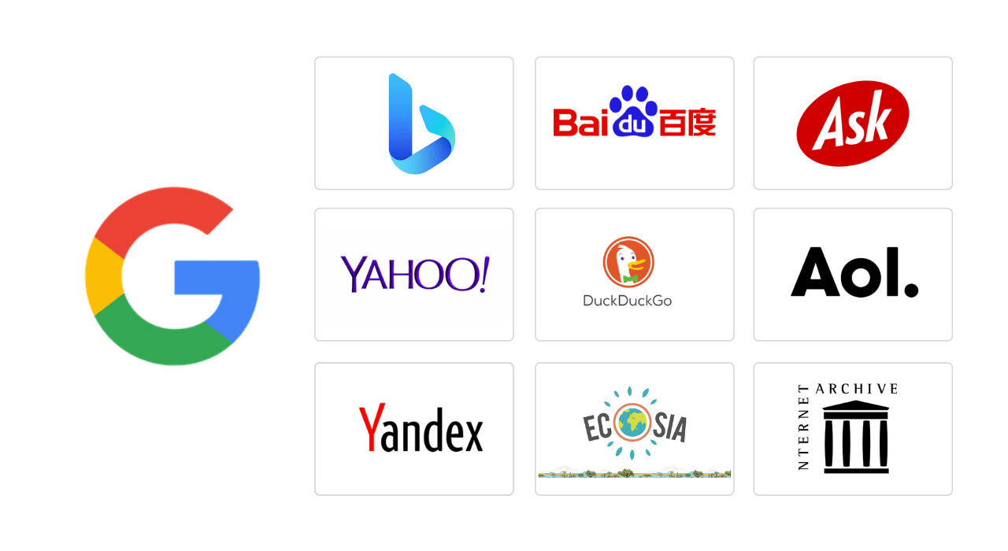
Search engine
A web search engine or Internet search engine is a software system that is designed to carry out web search (Internet search), which means to search the World Wide Web in a systematic way for particular information specified in a textual web search query. The search results are generally presented in a line of results, often referred to as search engine results pages (SERPs). The information may be a mix of links to web pages, images, videos, infographics, articles, research papers, and other types of files.
Reliablesoft

Slide 62
Some popular search engines
Google
Bing
Yahoo
Ask.com
Live.com
Alexa.com
Baidu
Yandex

Slide 63
Downloading and Printing web Pages

Slide 64
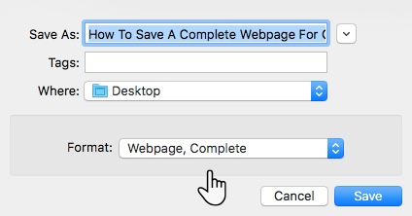
Downloading / Saving a webpage
There are times when you want to save a webpage for offline use. All major browsers have the feature to save complete webpages. Use the following methods to save webpages in different browsers
Save webpage in Google Chrome
Chrome has a Save As option.
You can access it from Menu (☰) > More Tools > Save Page As.
You can also use the keyboard shortcut Control + S on Windows.
Give the saved page a name. By default, the file will be named the same as the title of the page.
Select a location to save the page. After saving, you'll find the page's HTML file here, as well as a folder containing all of the media from the page if you choose to save the complete page.

Slide 65
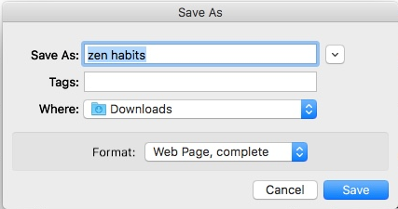
Downloading / Saving a webpage
2. Save Webpage in Firefox
In Firefox, click on the Menu button > Save Page.
The Save As dialog window will open.
In the Save As dialog window, type in a name for the page you want to save and choose a location.
From the Format drop-down, choose the type of file that you want to save the page as.
Choose Web page, complete option when you want to save the whole webpage along with pictures. This keeps the visual look intact in most cases

Slide 66
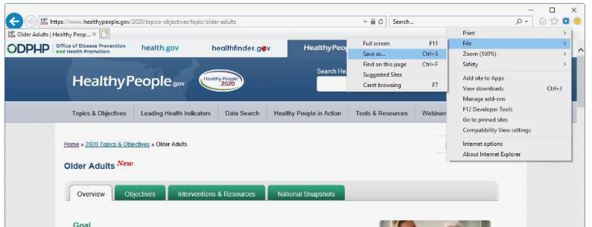
Downloading / Saving a webpage
3. Saving webpage in Internet Explorer
Select the Gear in the top-right corner of the browser window and select File > Save As.

Slide 67
Downloading / Saving a webpage
In the Save Webpage dialog, navigate to the folder where you want to save the file and select the Save as type drop-down menu to choose a format.Options include:
Web Archive, single file (*.mht):
Webpage, HTML only (*.htm;*html):
Webpage, complete (*.htm;*html):
Text File (*.txt):
Enter a name for the file in the File name text box and select Save.

Slide 68
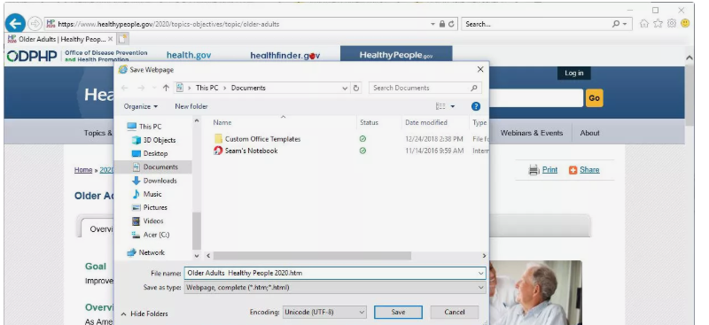
Downloading / Saving a webpage

Slide 69
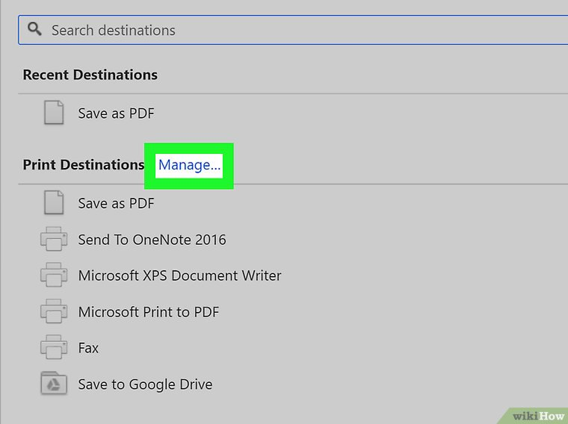
Printing a webpage
Open the page you want to print in browser (say Google chrome).
Press Ctrl + P shortcut. This opens the Printing window. A preview of the printed version of the page will appear.
(Because websites are made to be viewed on the screen, the printed version may look different than it does in your browser. Scroll through the preview to see what the print-out will look like, and then continue with this method to make any necessary changes)

Slide 70
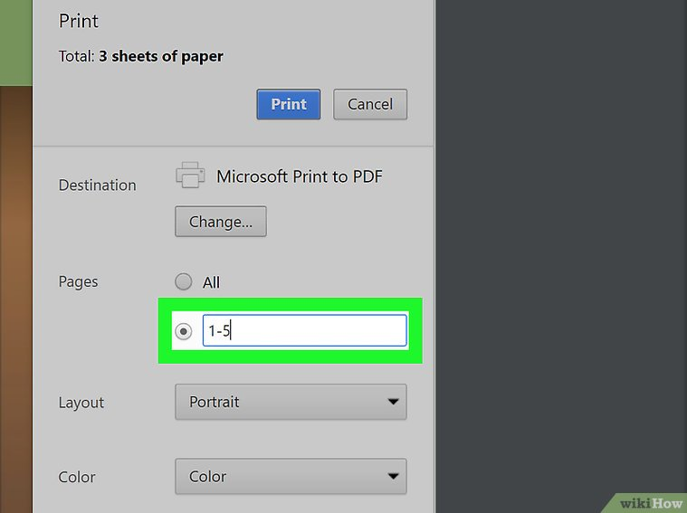
Printing a webpage
Select a printer: If the printer you want to use is not already selected, select it now.

Slide 71
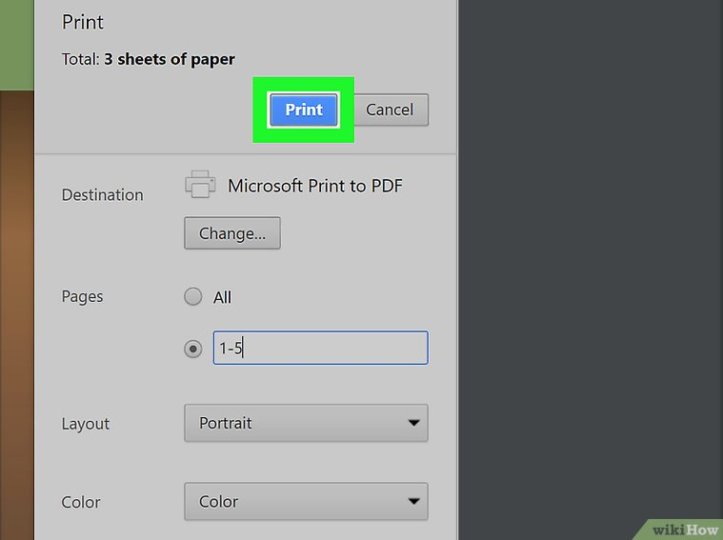
Printing a webpage
Select which pages to print: If you don’t need to print all of the pages that appear in the preview, enter the page range you want to print into the blank(s) under “Pages.”
Click the Print button.

